Slide 1
Customer Engagement Amid Crises Presentation
PLEASE READ THIS FIRST
Background and how to use this deck and individual slides
This presentation details key customer behavioral changes through 2020 and how they impact cross-functional customer engagement, digital transformation, and corporate citizenship. It takes key insights from our the fourth edition State of the Connected Customer report, published in October 2020 and based on an August 2020 survey of 12,000 consumers and 3,600 business byers across 27 countries. References for Additional Insights:
State of the Connected Customer Report
Connected Customer Tableau Dashboard
Connected Customer Toolkit
Salesforce Research Stat Library
Have a question? Contact Conor Donegan (cdonegan@salesforce.com).

Slide 2
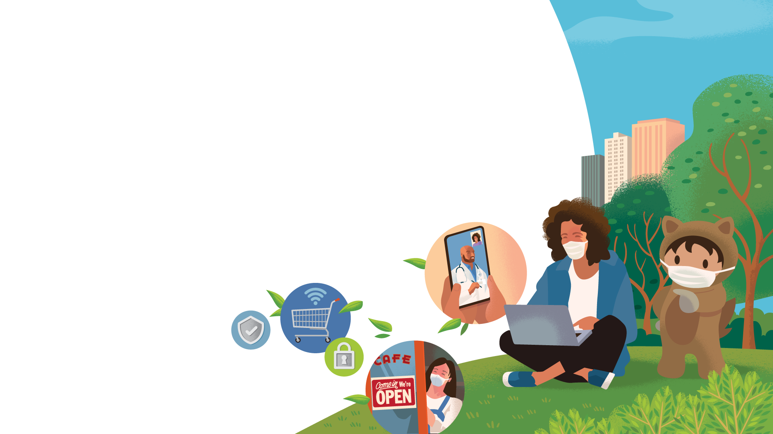
State of the Connected Customer
FOURTH EDITION
Insights from 15,000+ consumers and business buyers worldwide on unprecedented shifts in customer expectations and behavior
Notes:
HOLD SLIDE

Slide 3
Customer Engagement
Amid Crisis
Insights from the State of the Connected Customer report
Name, Title
Twitter | Email
Notes:
[INTRO YOURSELF AND SALESFORCE AND SESSION CONTEXT]
Today, we’ll take a look at the historical events we’re living through from a business standpoint.
We all know that 2020 has been an unprecedented year in so many ways, at least in our collective lifetimes. As individuals our first priorities have been our loved ones and hopefully ourselves and our collective health, and just navigating those changes and the endless info and data coming our way is hard enough.
In our professional lives, we also face the extreme challenge of rethinking our businesses not just for the current environment, but for the long term. Doing this is impossible without understanding our customers — their challenges, their shifting needs and expectations — and that’s what I’m here to talk about with you all today.

Slide 4
Businesses Are Facing a Lot of Unknowns
?
How do customer EXPECTATIONS and BEHAVIORS change during crises?
?
Is the trajectory of digital transformation shifting?
?
How can brands earn customers’ TRUST when it’s at a low point?
?
What are the implications for sales, service, marketing, and commerce teams?
?
Which changes are short-term and which are PERMANENT?
?
In what ways are customers evaluating companies on their paths to purchase?
?
What is the PURPOSE OF BUSINESS, exactly?
Notes:
Regardless of what industry you’re in, who you sell or market to, and where you operate, the past few years have been a rollercoaster of transformation. Customers have adopted new channels, competition has intensified, standards have risen. It’s a worn cliche, but it’s absolutely true that change has been our only constant.
Then came 2020, a year when the change kicked into inconceivable overdrive in terms of both speed and scale. Business leaders’ long standing quest to understand what their customers expect, how to orchestrate connected and differentiated experiences, and ultimately win loyalty and market share haven’t gone away, but they’ve become more complex. And as society deals with multiple concurrent crises — of health, economics, racial justice, and climate — businesses are being forced to contend with both acute and long simmering challenges.
In sum, there are a lot of questions to answer. We believe that a firm and holistic understanding our most important stakeholders — customers — is the key to navigating our current environment and, ultimately, coming out the other end stronger and more resilient to the challenges that lie ahead.

Slide 5
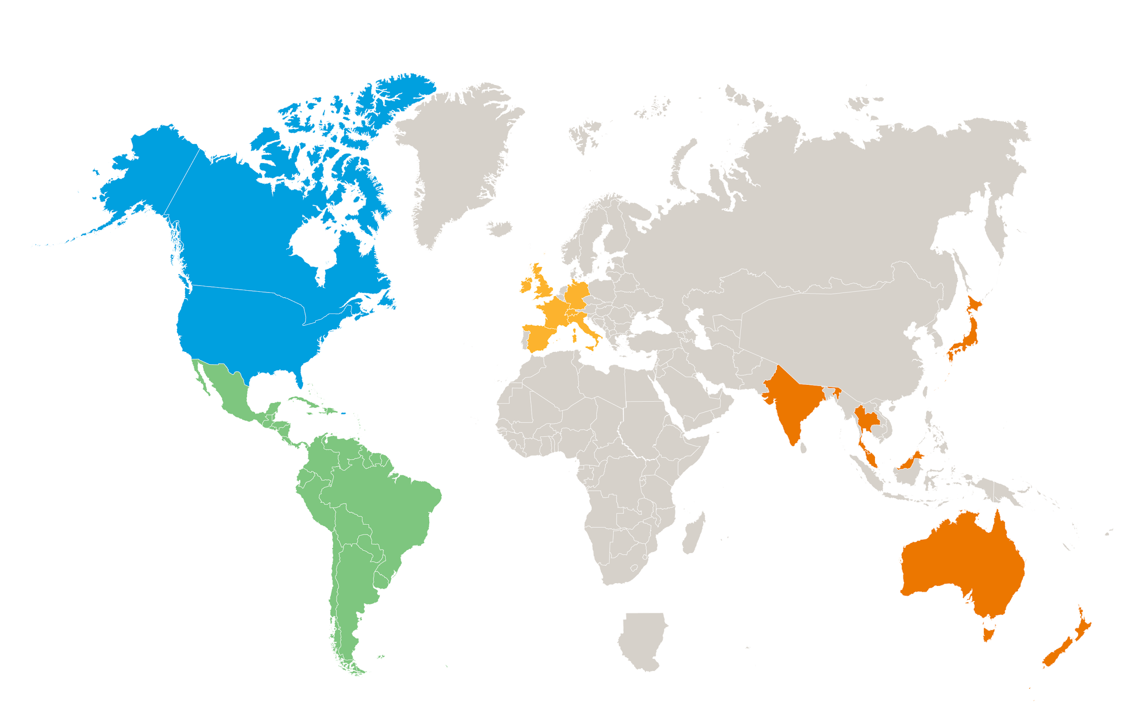
We Asked Customers About What They Need
Nearly 3,600
business buyers surveyed worldwide
z
27 countries
6 continents
4th year
Nearly
12,000
consumers surveyed worldwide
Notes:
The insights I’m about to share are from our annual Connected Customer study — a global survey in which we ask a randomized sample about their expectations of companies, buying behaviors, and decision making criteria among other topics.
What’s unique about this study isn’t just the sample size — nearly double the size of last year’s — but it’s global breadth and split sample of consumers and business buyers.

Slide 6
There is no return to “normal,” only a transition to the “NEXT NORMAL.”
Notes:
It’s important to recognize that we’re truly in a new era in which we’ll need to reconsider the standards of customer engagement, operating models, and nearly every other criteria that we’ve taken as granted for so long.
It’s common these days to hear the refrain of “when things get back to normal.” but to move forward we need to accept that there really isn’t a normal to return to from here. In 2020, western civilization experienced its first true shutdown of social and economic activity in generations, and it prompted us to not just curtail activities in the interest of public health, but consider a better future — in which we live, work, shop, treat each other, and treat the planet differently.

Slide 7
We’re Entering a New Era of Customer Engagement
63%
of customers say how they obtain goods and services has transformed during 2020
78%
of customers believe current crises should catalyze business improvement
57% of customers say how they engage companies has transformed during 2020
Notes:
Just take a look at how much has changed over the course of a few months. Shopping has gone online. Meetings have migrated to Zoom. Convenience has been redefined
Customers are changing — out of necessity and choice — and they expect the companies they do business with to follow suit.

Slide 8
“Change is the law of life. And those who look only to the past or present are certain to miss the future.”
John F. Kennedy
Notes:
We’re in a moment when individuals, governments and yes, businesses, are at a crossroads. Some will devote their scarce time, energy, and resources for a time that no longer exists, while others will embrace the trends happening now to both weather the current storm and set themselves up for future success and growth.
Alt quotes:
We have a rare and short window of opportunity to rectify [our ills] — by rebuilding a better world, not reverting to one that is good for only a minority of its citizens. - Antonio Guterres
https://www.nytimes.com/2020/04/28/opinion/coronavirus-climate-antonio-guterres.html

Slide 9
The digital transformation PLAYBOOK HASN’T CHANGED. THE TIMELINE HAS.
Notes:
The most obvious shift is the rapid pivot digital as the primary medium for how we live, work, and shop.
Step back and picture a modern pandemic life without ecommerce or videoconferencing. What would that even look like? Luckily for our health, economy, and sanity, these technologies, among others we’ve come to rely on in new and amplified ways, were very much in use. The digital transformation framework that has kept us afloat this year was already established, and the trends we’ve experienced we’re already happening, albeit at a much slower pace.
We’ve seen some companies with robust digital capabilities positively thrive in our current environment — think Amazon, Zoom, or retailers that embraced ecommerce and curbside pickup. At the same time, we’ve seen countless businesses that were ill-prepared for digital-first engagement flounder and even fail.
The time to double down on digital transformation is now, and not just for the purposes of weathering our current moment.

Slide 10
Digital Engagement Has Crossed a Threshold
Customers Estimated Split of Online and Offline Interactions With Companies
61%
of customers expect to spend more time online after the pandemic than they did before
Online interactions
Offline interactions
2019
42%
58%
2021
60%
40%
43% growth in share of online interactions
Notes:
Your customers may not like why they’ve shifted certain parts of their lives online, but the majority of them like some of those shifts, themselves, enough to make it permanent.
Over two-thirds of our survey respondents said they’re online more often than they’re not, and it seems that trend is here to stay. The predictable rise in in the share of customer/company interactions that take place online — which hit a tipping point by skyrocketing to approximately six in ten this year — is expected to persist in 2021. Asked explicitly about their expectations for post-pandemic habits, 58% of consumers expect to conduct more online shopping than they did before our current crisis, and 80% of business buyers say they’ll conduct more business online.
So the obvious question for companies is, are you building the capabilities — be it in terms of technologies, organizational structure, processes, or otherwise — that will keep an increasingly online customer base engaged and loyal?

Slide 11
Customers Are Calling on Companies to Transform Faster
88%
of customers expect companies to accelerate digital initiatives due to COVID-19
68%
of customers say COVID-19 has elevated their expectations of companies’ digital capabilities
Notes:
Your customers don’t just expect that you’re embarking on digital transformation of your own, but that the pandemic has accelerated and amplified your plans.
But it’s not as simple as flipping the digital transformation switch. Many businesses fail at this because they pour new technology over old thinking. These systems were designed in a world that was analog and product-centric. Now the world is digital-first and customer-centric. You can’t simply digitize the analog and expect major transformation to happen. You’ve got to reinvent it. True digital transformation is when, bearing in mind everything you know, you approach the product from first principles. What you end up with is a different answer than the analog and, in many cases, a much better experience. That’s what’s going to happen in every industry.

Slide 12
Standards for INNOVATION HAVE EVOLVED.
Notes:
The advances we’ve seen in technology over the past decade, in particular, can go unappreciated given just how commonplace in our everyday lives they’ve become. But many of them are truly awe-inspiring and it’s worth taking a step back. The roll out of 4G networks gave us access to unprecedented processing power in our pockets. Instagram, TikTok, and other social networks gave us new ways to connect with brands, friends, and loved ones. Cloud computing untethered us from our desktops and gave us instant access, anywhere, to the information we need (Where would we be without Google Docs?). IBM’s Watson beat contestants on “Jeopardy.”
Used to a common stream of innovation, customers’ standards for what constitutes a true breakthrough are much higher than they used to be, raising the bar for companies.

Slide 13
Innovation Is More Critical and Complex
In response to COVID-19...
68%
of customers want new ways to get existing products and services
54%
of customers want new products and services
Notes:
When we think of innovation, our minds often turn immediately to new products and services. To be sure, more than half of customers expect new items that reflect our current environment. Who’d ever think, for instance, that Hanes would sell ten-packs of cotton face masks?
But the pandemic demands that we think a step beyond this. Loyal customers stick with companies due to a combination of products/services and, experiences. So even more than they want new products, customers want new ways to experience the existing products they’ve loved all along. And just like everything in 2020, these new ways are primarily digital in nature.
We see innovative ways that businesses have met this demand. Movie theaters have turned their parking lots into drive-ins. Restaurants have replaced paper menus with digital ones accessed through QR codes.
Let’s do a deep dive on a particular example...

Slide 14
Enhancing Efficiencies for Increased Product Demand to Help Fight COVID-19
Quickly able to shift product request intake process by funneling the right data to crisis response teams
Scales with surge in product demand through automated processes
Drives sales conversions by providing a 360-degree view of prospects and aligning sales, service, and marketing teams
Improves key reporting by tracking critical data & campaign attribution
87+
countries reached
4.8K+
Salesforce users
SALES
SERVICE
MARKETING
Notes:
Esri is the global market leader in map technology, specifically ArcGIS, the world's most powerful mapping and spatial analytics software used to reveal deeper insight into data. By connecting everyone, everywhere through a common visual language, Esri helps organizations create positive change in industry and society, especially during times of disasters and crisis.
Amidst COVID-19, Esri had to pivot their technology usage because of a huge surge in demand for tracing software. The Salesforce platform allowed the company to build an intake process to help funnel data mapping requests into their crisis response teams. All of this information flows into Service Cloud to help track, manage, and report on these cases. This 360-degree view starts as soon as a prospect engages via the company’s website and intake form. With Pardot, every new lead is scored and assigned to a team based on location.
After deploying this solution, Esri has seen an increase volume in requests from various government agencies, technology companies, and over 130 countries to help fight the pandemic supporting both the World Health Organization and FEMA, as well as the John Hopkins Covid Map.

Slide 15
AI Brings Opportunities as Its Role Becomes Clearer
“I’m open to the use of AI to IMPROVE MY EXPERIENCE.”
46%
of customers can think of AI they use every day — up from 40% in 2019
66%
64%
60%
52%
Baby Boomer
Gen Xer
Millennial
Gen Zer
Notes:
Increasingly, innovation is being driven by AI. Think of what’s been made possible in our lives, for example, thanks to Siri and Alexa, or the notifications we get from Google Maps or Waze to leave on time to beat traffic, or the music Spotify recommends that we try.
The reality is, AI is embedded in nearly all of our daily lives whether we know it or not. Since 2019, the share of customers who recognize at least one example of AI they use every day rose significantly.
Younger generations are particularly open to the use of AI to improve their experiences, but even a majority of baby boomers shares the sentiment.
A natural question is not if AI can play a role in your digital transformation strategy, but how. It’s a million (or more) dollar question: A minority of sales, service, and marketing leaders surveyed for recent Salesforce studies claim to have completely defined AI strategies.

Slide 16
It’s not enough to engage customers.
YOU HAVE TO CONNECT WITH THEM.
Notes:
We’ve talked a lot about what customer engagement looks like today. But if you take one thing away from my presentation it’s this: engagements can not be thought of in the individual, one-off sense — to truly meet customer expectations, individual engagements must be thought of as parts of a holistic experience, with each interaction informing the next.

Slide 17
Understanding, Empathy, & Connections Underpin Engagement
66%
of customers expect brands to understand their unique needs and expectations
76%
of customers expect consistent interactions across departments
68%
of customers expect brands to demonstrate empathy
Notes:
Think of the difference between an acquaintance and a friend. An acquaintance may know a little about you — your name, your job, which city you live in — but they don’t have the full understanding of your personality, your quirks, your needs. True understanding is impossible between acquaintances, whereas true friends know each other well enough to understand what makes them happy, what soothes them, and ultimately what they need. In other words, friends empathize with each other.They support each other, give advice, and demonstrate concern for what’s best for them.
The same is true of the relationships between customers and brands — if on a more limited scale. In fact, 53% of customers say they feel an emotional connection to the brands they buy from the most. Customers expect their favorite companies to treat them like a unique individual with unique needs and expectations — such as when they receive an email with a personalized offer that complements a recent purchase, or when they get counsel on the best way to meet their business goals rather than straight product pitch.
To take the metaphor a step further, think of a group of friends. They compliment each other, support each other, and in the best cases, band together to throw a surprise birthday party (or not, if they know you’ll hate it). Think of your sales, marketing, service, and ecommerce teams, and customers as a group of friend. Much like one friend may tell another that you had a bad day and may need some space, your customer service team may let your marketing team know of an open case and that they might want to hold off on sending that email until it’s resolved. This type of united front is a connected experience that matches how customers actually view brands: a single company, not disparate departments.

Slide 18
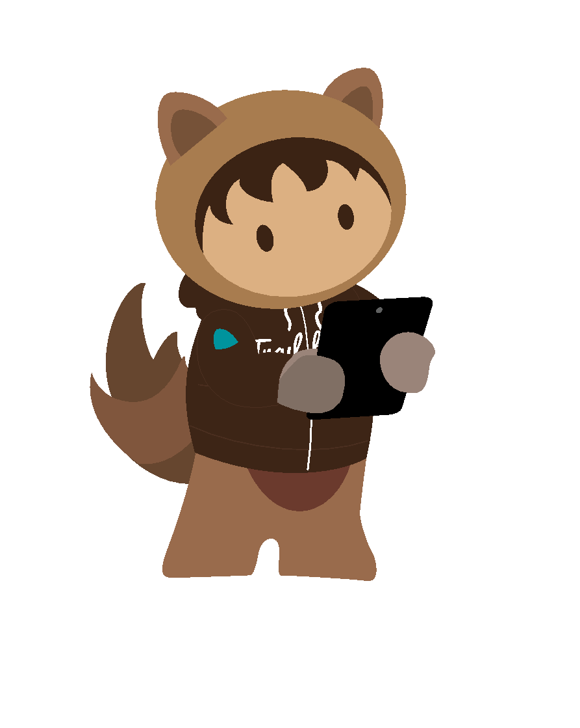
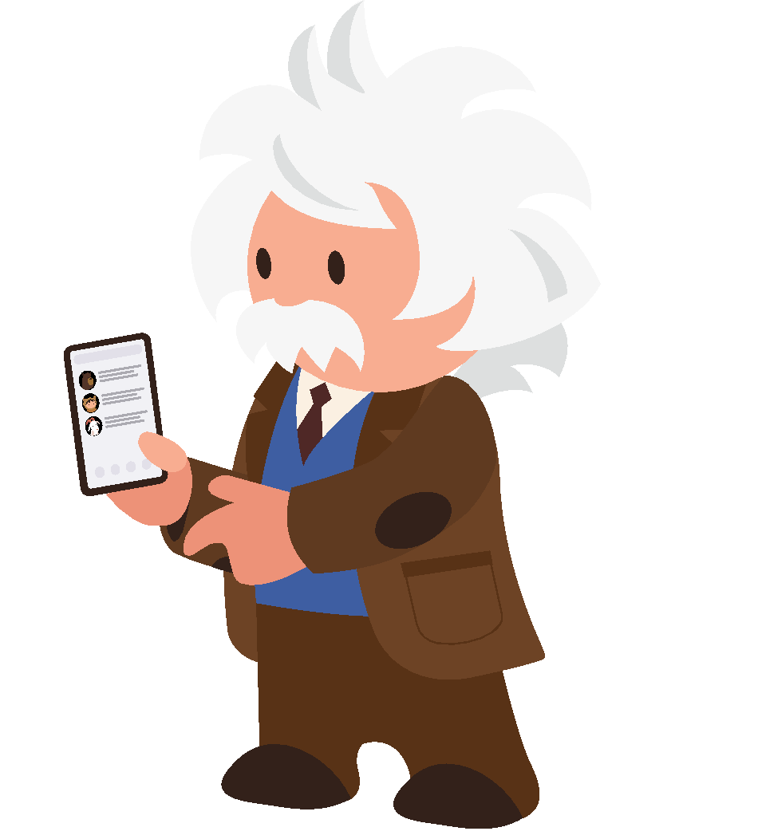
Disconnected Experiences Persist Despite Rising Standards
37%
of customers say brands demonstrate empathy
54%
of customers feel that sales, service, and marketing don’t share information
34%
of customers say brands treat them as unique individuals
Notes:
In reality most companies aren’t meeting customers’ expectations for understanding, empathy, and connected experiences.
The roots of this disconnect are antiquated processes, organizational structures, and infrastructure that haven’t caught up with customers’ changing needs and expectations. This isn’t just a customer experience problem — it’s also an employee experience problem. If an organization doesn’t enable employees with the resources they need to live up to expectations, customers will suffer and ultimately defect. When employees are connected, however, the result is happier customers and more fluid operations.
Let’s look at an example of what this looks like in practice...

Slide 19
Taking Employee Satisfaction and Customer Service to Greater Heights
Built app to manage, standardize, and report workgroup engagements across 90+ locations
Service agents gained 360º view of customer and automation tools for enhanced productivity
Use accessible features of Service Cloud and offer various channels like Chat & Self-Service
15 → 1
system consolidation into single customer view for agents
“We wanted to partner with a company that’s known for innovation and that would keep us continuously moving forward. Salesforce is the perfect fit for that.”
Erica Tyler Director of Business Strategy
SERVICE
CUSTOMER 360 PLATFORM
Notes:
Southwest Airlines Co. is a major United States airline headquartered in Dallas, Texas, and is the world’s largest low-cost carrier. The airline has more than 58,000 employees as of September 2018 and operates more than 4,000 departures a day during peak travel season. As of 2019, Southwest carries the most domestic passengers of any United States airline.
Business Challenge:
Southwest Airlines stands apart from the competition because of its great customer service. The foundation of that exceptional service is its employees, so the airline places high priority on their happiness. Southwest believes that happy employees means happy customers.
But improving employee satisfaction isn’t easy, especially with increasing workloads. Many employees work in remote locations and are eager to stay connected to the greater corporate culture. Databases that managed these processes were siloed from each other and difficult to maintain. Because employees and departments are scattered across the U.S., central IT relied on local IT teams to troubleshoot problems and deal with siloed applications. But those local teams were limited in what they could do because of corporate compliance protocols.
In the contact center, agents connect with the millions of consumers a year who choose Southwest their preferred travel partners. With data spread across systems, service agents had to consult several different tools to get the information needed to create a truly personalized experience. That inefficiency created stress for agents and travelers. As the airline continued to expand, taking on higher volumes and more complex cases, they needed a service solution that could empower their agents with the right information at the right time, and let them focus on delivering personal and trusted service to the consumer.
SWA had to address these concerns with a new CRM that streamlined workflows, allowing them to scale service without sacrificing the personalization that is such an important part of its competitive advantage.
Salesforce Solution:
In 2018, Southwest embarked on a digital transformation.
In one year, it:
Deployed Service Cloud to bring disparate databases into a single screen with the Lightning Service Console, giving service agents the contextual information they need to create personalized experiences
Rolled out Service Cloud Chat as a channel of choice embedded within their mobile application, providing customers the opportunity to get support while in-flight
Implemented new tracking systems to ensure all Southwest employees are receiving consistent culture engagements, despite their location
Southwest can now provide service across different channels, putting the choice in the hands of the consumers, even while in flight. Personalization and customized offers create new business opportunities for Southwest while simultaneously helping to better satisfy customers’ needs. Southwest built the solution in partnership with their agents, working with them to optimize the Lightning Service Console and ensure data was accessible and convenient while handling cases. Their Agent Advisory Board represented their full community of agents: across tenure, ability (including agents who are visually impaired), location and skill level – making the Lightning Service Console a solution that was a fit for each and every agent. By pulling in in external data like reservation information and flight status, Southwest agents are armed to help the customer efficiently.
Using the Salesforce Platform, Southwest developed apps that allow it to streamline workflow and better connect far-flung employees with the corporate culture. The app gives the Culture Engagement Services team the ability to manage, track, report and understand location and workgroup engagement efforts for management of all locations across the United States. The app includes a tactic library for new culture committee members to easily find and run employee culture activities
Results:
15 systems consolidated into a single Lightning Service Console, enabling a single view of the customer for agents - reduced need for swivel chairing across multiple systems
Over 30% of calls will be deflected to chat
Agents can handle multiple cases at one time and help customer issues get resolved faster than ever before using Chat
An estimated $2.8 million annually is saved in HR services thanks to HR Case Management, Knowledge Management, and an employee self-service community
Greater employee connectivity and happiness due to the use of Platform-based apps that track employee needs
Vision:
Einstein for added intelligence with tools like Next Best Action
Leverage Einstein Bots – getting customers help instantly as well as assist their agents to streamline our processes and increase efficiency.
Additional digital channels like SMS and WhatsApp to provide channels of choice for customers
Increased data insights with Einstein Analytics
Workforce development with tools like Trailhead for onboarding

Slide 20
Trust is at a low point. ITS IMPORTANCE IS AT A HIGH POINT.
Notes:
Providing empathetic, connected experiences yields another critical benefic: trust.
Would you be friends with someone you don’t trust?
Would you do business with a company you don’t trust?
We’re in a multifaceted crisis of trust, and brand-customer relationships are on the forefront.

Slide 21
The Crisis of Trust Is Intensifying
52%
of customers say they don’t generally trust companies
A company’s trustworthiness matters more than a year ago
It’s difficult for a company to earn my trust
73%
54%
2019
82%
61%
2020
Notes:
We are now at a point at which the majority of customers say they generally don’t trust companies. That’s concerning, considering the trends we’ve seen since just last year that indicate a significant degradation of customer trust, and a higher bar set for earning it.
At the same time as trust declines, it’s importance is rising. During a time of multiple crises, lives put on pause, and misinformation, trust is truly a valued commodity.

Slide 22
Transparency Is in Short Supply
z
27% of consumers say they completely understand how companies use their personal information
86%
of customers want more transparency over how their personal information is used
I feel like I’ve lost control over how my personal information is used
2019
46%
2020
61%
Notes:
In a digital-first world, customers’ trust in companies is driven in no small part to a critical ingredient in modern customer engagement: personal information.
The personalized, empathetic, connected experiences customers have come to expect as standard are driven by sophisticated -- often automated -- analysis of personal data. Using data to meet customer expectations doesn’t require nefarious acts: think purchase history informing personalized offers or ecommerce data made accessible during customer service interactions. But flush with news reports of data mismanagement by household name brands and privacy agreements that require a law degree to decipher, customers are largely confused about and wary of how the information they’ve volunteered is used, exactly. Between 2019 and 2020, we’ve crossed a grim milestone at which a majority of customers feel they’ve lost control of how their data is used.
Rebuilding customers’ trust in companies’ stewardship is dependent on a critical ingredient: transparency. Ironically, a critical asset in the fight against COVID-19 may build greater understanding of and trust in the data-value exchange.
As a financial services company catering to individuals and small businesses, PayPal bases a lot of its value on its trustworthiness...

Slide 23
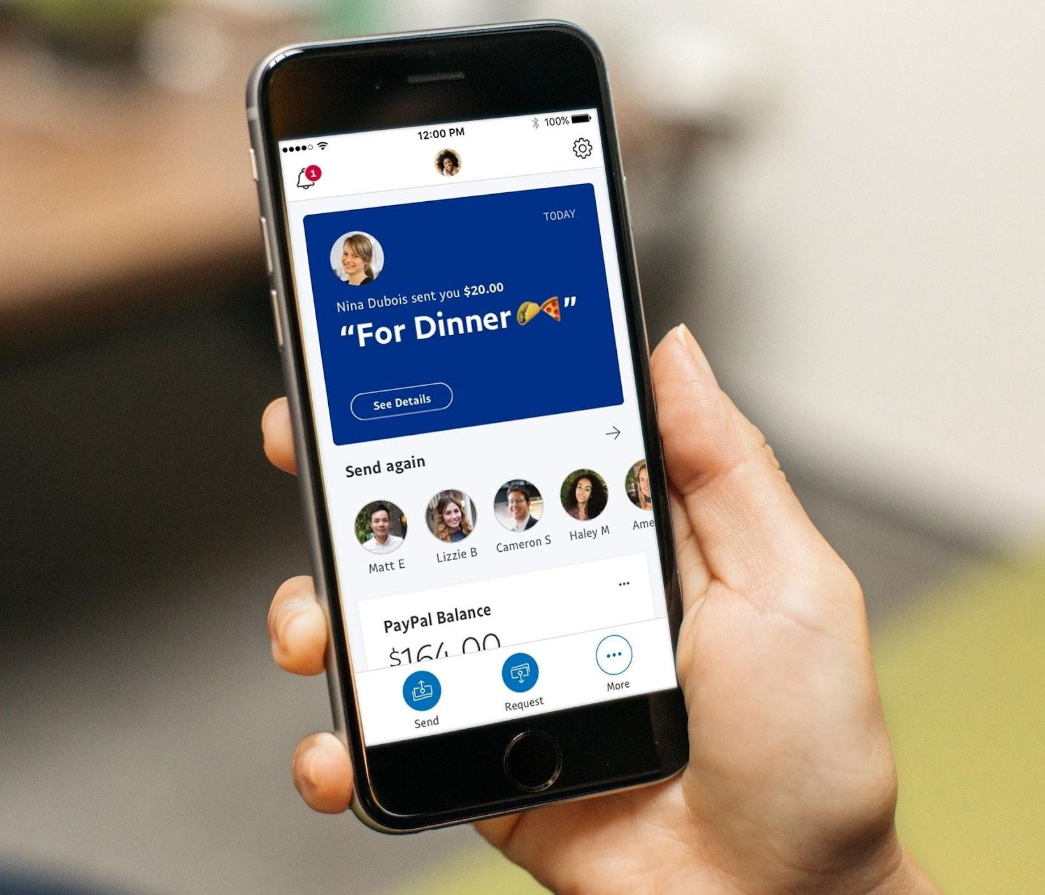
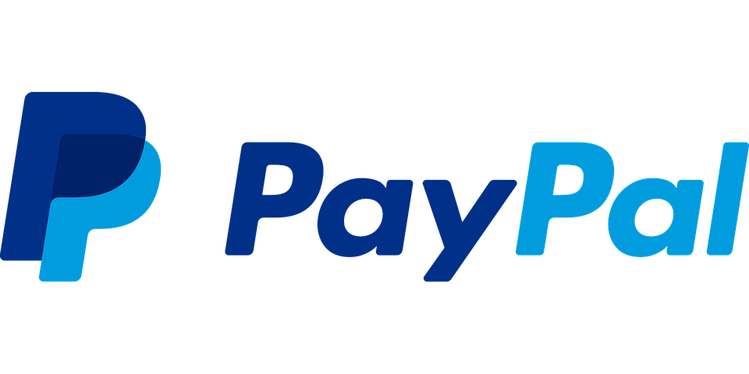
Unifying the Employee Experience for a
More Connected and Secure Customer Journey
Enables full data visibility and forecasting to better meet customer needs while keeping protected information safe
Integrates and surfaces all data and insights to help inform the sales cycle including information from acquired businesses
Empowers service representatives to confidently act as trusted advisors and personalize customers’ e-commerce journeys
Empowers 3rd party developer communities to leverage the secure API ecosystem
4 → 1
system consolidation in Salesforce
SALES
SERVICE
MARKETING
ANALYTICS
INTEGRATION
EMPLOYEES
LEARNING
SUCCESS
PARTNERS
SECURITY
EXPERIENCE
Notes:
PayPal is a global online payments system, working to transform e-commerce and help businesses thrive online. P
ayPal has experienced tremendous change and growth in order to support their evolving customers, where customers were once asking for a point solution for the checkout on their website, they now are looking for a commerce partner that provides them everything. When COVID hit, PayPal was forced to accelerate their digital transformation and move 98% of their employees online, as well as manage a world where many businesses moved to an eCommerce first model.
Leveraging Sales Cloud, PayPal is consolidating processes and systems to help accelerate its sales cycle and collaborate as it focuses on delivering solutions to its customers. Teams previously had disparate solutions and processes that made it difficult for reps to have a holistic view of the customer and act as trusted advisors. Now, sales and teams have the data to better understand their customers and can visualize that information with Tableau to make business decisions. With Salesforce CPQ and Sales Anywhere (Quip), PayPal looks forward to accelerating deal cycles and global account management.
PayPal is working to reimagine customer service with Service Cloud to improve first call resolution and C-SAT scores while also reducing customer churn. Shield allows PayPal to securely encrypt customer data keeping the customer at the center of everything they do.
Marketing Cloud powers communications with Xoom, iZettle, and Swift customers providing personalization across every point of the customer’s journey.
MuleSoft also helps with security by guarding data from hackers, automating over 80% of those security processes to respond faster than any criminal. PayPal's goal is to have a billion people using their service securely. By partnering with MuleSoft, PayPal overhauled their homegrown API infrastructure and deployed a modern API infrastructure and deployed a modern Additionally, MuleSoft guards PayPal data from hackers, automating over 80% of those security processes to respond faster than any criminal.
MyTrailhead is ensuring sales and teammates are learning and growing with the best methods to work with the customer.
PayPal has partnered with Salesforce certified partners along with Salesforce’s CSG group to set PayPal up for implementation success, streamlining its overall processes, provide guidance on how to best unify its people and overall technologies.

Slide 24
Contact Tracing Offers a Turning Point in the Data-Value Exchange
66%
of customers expect brands to demonstrate empathy
63%
of customers expect COVID-19 to change how people think about their personal information
76%
of customers expect consistent interactions across departments
Notes:
The path from a Google search to a retargeted ad may be mystery to most customers, but another high-profile use case for personal information: contact tracing.
Contact tracing represents something unique: a clearly beneficial use case, reliant on data, with broad public understanding and buy-in.
The question remains: Will companies take a page from contact tracing playbook and better articulate the benefits of the customer-business data value exchange?

Slide 25
Corporate citizenship is increasingly steering the PATH TO PURCHASE.
Notes:
Personal information plays an outsized role in building or dismantling customer trust. But it would be short-sighted to boil a concept as large as trust to one factor.
During 2020, the population has confronted more than an acute public health crisis. They’ve also been reminded of a toxic cocktail of racial injustice, community divestment, environmental destruction, and more. Activism has been on the rise, but it comes in more forms than high-profile marches. It’s increasingly apparent in our decisions of whether or not to buy from a company.

Slide 26
Values Can Build or Diminish Revenue
Consumers Who Say the Following Influence Their Decision to Buy from a Company
z
Total
82%
85%
78%
73%
76%
72%
61% of customers have stopped buying from companies whose values didn’t align with theirs
86%
87%
85%
83%
83%
82%
81%
80%
79%
77%
76%
77%
75%
74%
74%
73%
73%
70%
70%
Treatment of
employees
during this
year’s crises
Treatment of customers
during this
year’s crises
Environmental practices
Actions on racial injustices
Actions on economic injustices
Community involvement
Baby Boomer
Gen Xer
Millennial
Gen Zer
Notes:
Over six in ten respondents told us they stopped buying from companies whose values didn’t align with theirs.
There are a lot of factors that tell customers who companies are and what they stand for. Community involvement has long been the most visible sign, and it’s still a major factor. But 2020 has raised the profile of corporate actions on a variety of different, and equally as important, issues. Businesses are among the many institutions being called on to advance racial equality in long overdue ways.The increasingly apparent and destructive impacts of climate change are putting companies’ environmental practices under the microscope. And as essential workers put themselves in danger to care for each and everu one of us, customers now keep a sharp eye on the equity, wellbeing, and safety that companies provide their employees.

Slide 27
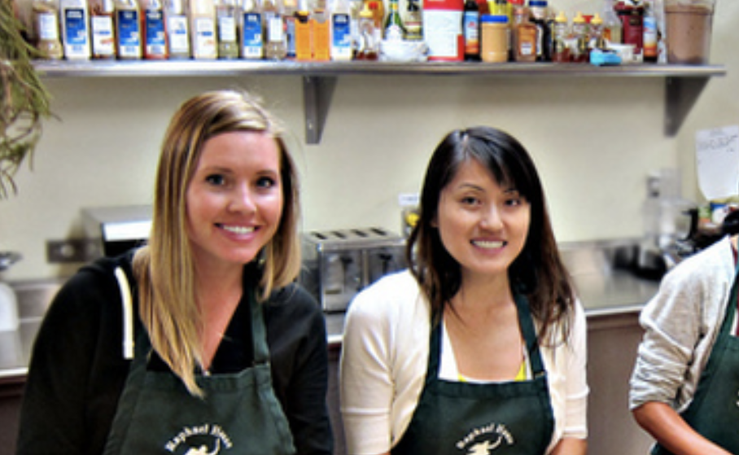
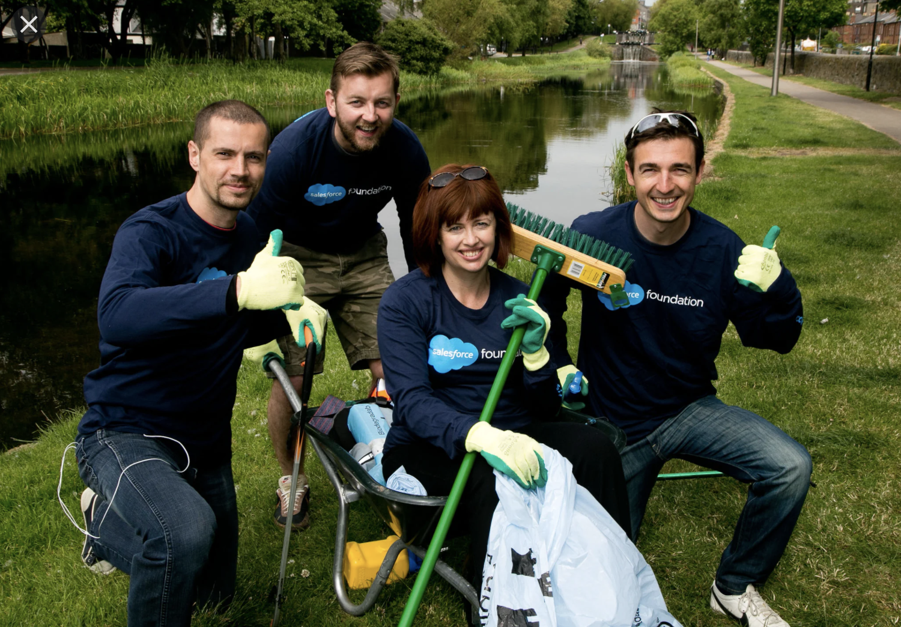
The Call for Stakeholder Capitalism Grows Louder
90%
of customers say how a company acts during crisis reveals its trustworthiness
56%
of customers have reevaluated the societal role of companies this year
Notes:
Now, we have an opportunity and duty like never before to demonstrate our trustworthiness as businesses through by making commitments and taking actions that align with our values.

Slide 28
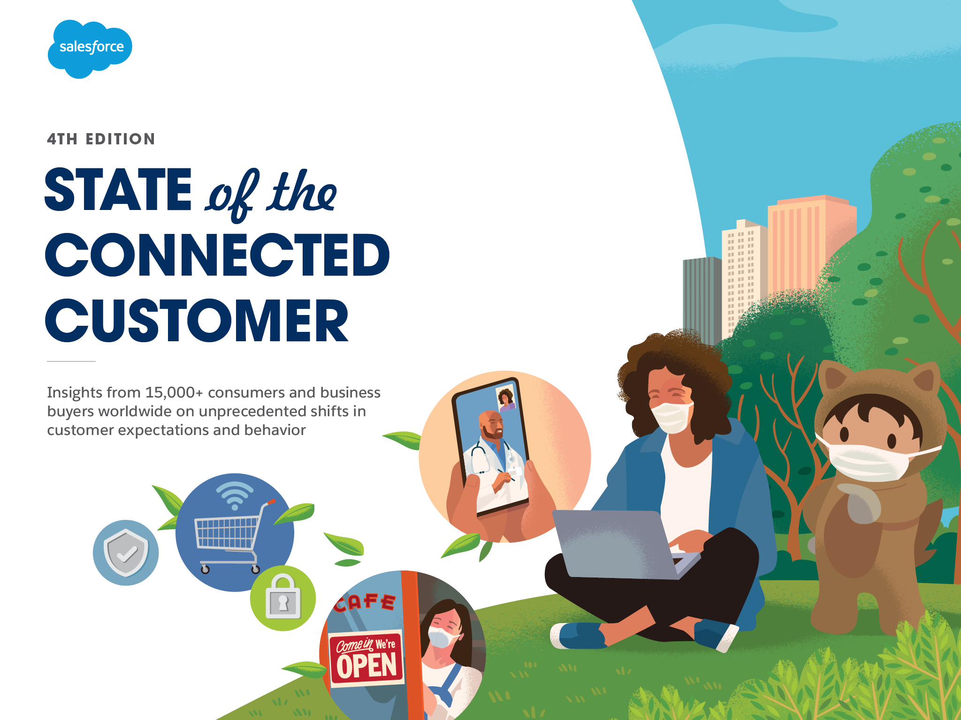
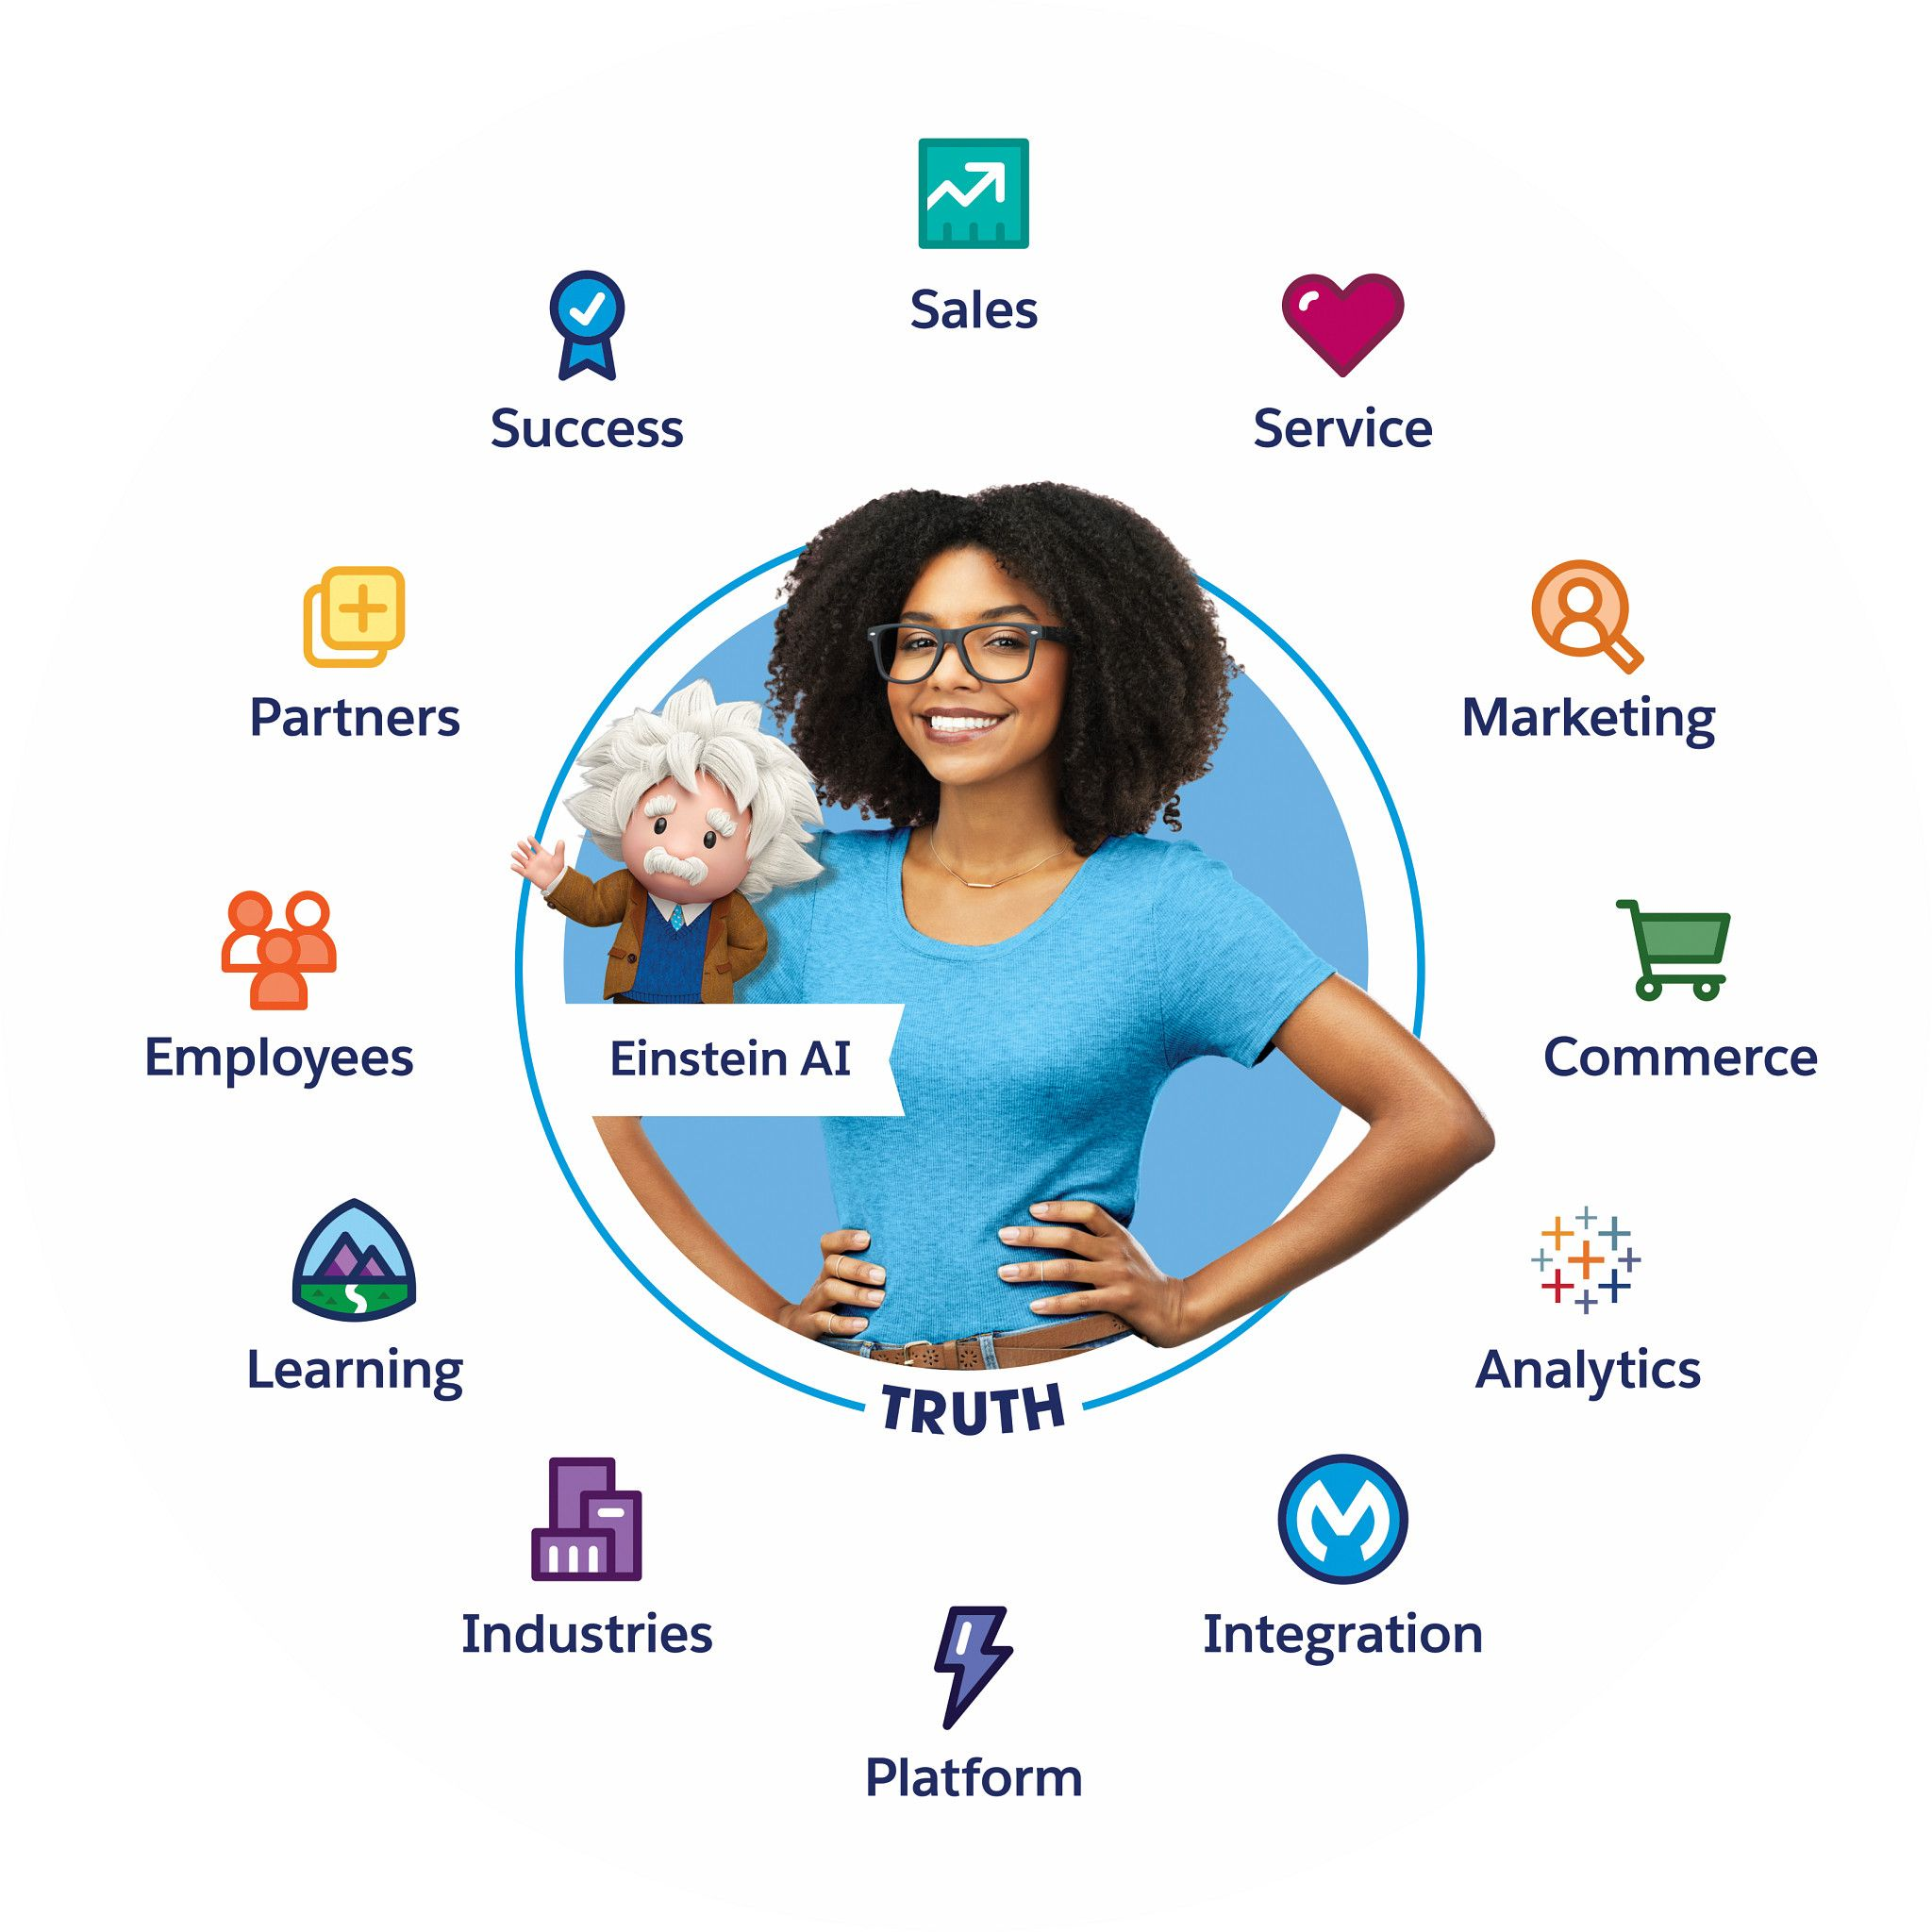
Learn More
Get the full “State of the Connected Customer” report for a download on all the trends changing customer engagement. GET THE REPORT >
Browse our interactive Tableau dashboards to understand shifts across customer types, generations, and geographies. EXPLORE THE DATA >
Learn how the world’s #1 CRM helps connect to your customers by uniting sales, service, marketing, commerce, IT, and analytics. MEET CUSTOMER 360 >
Notes:
I hope this both valuable and interesting to you. If you want to learn more, I invite you to get a copy of the full report for yourself, or check out the interactive Tableau dashboards we’ve put together where you can slice and dice the data yourself.
Salesforce can empower you take your customer engagement into our next normal. You can take a tour of our Customer 360 platform to see how.

