Slide 1
Knowing our customers
Using Thunderhead ONE Engagement Hub and Dynamics 365 Julian Elvé
Director of Information Services
SSAT
CC BY-NC-SA SSAT (The Schools Network) Ltd.
Notes:
SSAT, the schools, students and teachers network, is driven by finding and sharing "fresh idea for ambitious schools".
To make best use of our member's time, and at the same time give our sales team the most effective process for starting sales conversations, we aim to inform every action we take with a customer by everything else we have done with that customer.
Two key tools are Microsoft Dynamics 365 and Thunderhead ONE. I gave a presentation about how we use these tools together at the DYN365UG UK Chapter meeting, 14th November 2017 at Microsoft Reading - this is the slide deck.
Thunderhead slides copyright Thunderhead Ltd, used with permission, all other content copyright SSAT (The Schools Network) Ltd 2017, licenced Creative Commons Attribution-NonCommercial CC-BY-NC

Slide 2
Knowledge
Experience of what works in great schools
Learning
School improvement beyond quick fixes
Collaboration
Mobilizing longest standing network in the country
Framework for Exceptional Education
The Exchange
Student Leadership Accreditation
Expert consultants
High quality CPD programmes
National Conference
Sunday Supplement
SSAT Journal
Relationship Manager visit and ongoing support
Member email forums
Educational Outcomes database
CC BY-NC-SA SSAT (The Schools Network) Ltd.
Notes:
Schools are exceedingly complex organisations, and at SSAT we interact with teachers and school leaders many ways

Slide 3
Dynamics 365
Primary “source of truth” about customers
Mixture of Sales / Team Members
66 licences
Migrated from legacy CRM in 2013
In-house customisation
Key integrations:
MailChimp | via PowerMailChimp
Xero | custom code integration
SSO | custom code integration
Thunderhead ONE | mixture of Thunderhead features and custom integration code
CC BY-NC-SA SSAT (The Schools Network) Ltd.
Notes:
Our customer data system is built around Microsoft Dynamics 365

Slide 4
Our goal for customer knowledge
“Every interaction we have with a customer to be informed by every other interaction we have had with that customer”
For example:
Face-to-face conversations
Calls
Emails
Booking an event
Attending an event
School becomes a member
Web browsing
Opening marketing emails
CC BY-NC-SA SSAT (The Schools Network) Ltd.
Notes:
However the data in Dynamics is only one aspect of what we know about our customers. Our goal is to capture and surface in a usable form information about every interaction

Slide 5
The ONE Engagement Hub
Key addition to the mix….
Notes:
We have found that Thunderhead ONE Engagement Hub is an excellent partner system to sit across our customer touchpoints.
This slide and the next one is © Thunderhead Limited, used with permission

Slide 6
The framework for ONE
ONE Engagement Hub
CONVERSATIONS
Personalise
Descriptive
Predictive
Journey-based
ENGAGEMENT ANALYTICS
Analyse
Customer
Journey
Conversation
OMNI-CHANNEL CUSTOMER VIEW
Recognise
Cross-channel recognition
Listening
Customer behaviour
Notes:
The value of ONE as a customer ecosystem solution increases at the number of touchpoints gets “plugged” into it. The function of ONE as part of the customer operating system is to sense and respond to customer interactions and events regardless of where they occur.
ONE therefore has it “ears” on the ground continually listening for signals from these ecosystem solutions and uses those signals to get a better understanding of the customer to be able to deliver the appropriate customer centric response.
It it not enough to listen to or understand the customer experiences, you need to listen in such a way to understand and recognize customer intent. It is important to understand how customers/visitors behave across touchpoints to ensure you fully capture all signal to gain a deeper understand of intent. This can only be done if you recognize those customers as to move between these touchpoints and have the ability to understand how these cross-channel behaviours impact an understanding of what, needs and preferences.
Customer behaviour changes over time and it is important for a brand to early on identify that change in behaviour, what is the commonality in people behaving that way and then understand what impact the change in behaviour could have. To do this a brand needs to be able to the commonality in :
customer attributes, ie. age, geographies. transaction value, products owned,
behaviour over time as the progress on their journey at achieve their goal, and
how they respond to personalization efforts (conversations).
It is key to understand how these 3 relates and how the combination of analysing these facts across 1,000’s and millions of customers impact their level of engagement. Some of the analysis methods used in each of these areas are:
- Customer
Understanding customer interested using degradation algorithms.
Clustering customers using algorithms like DBSCAN to recognize relationships between attributes
Journeys
Identifying the most common path for customers
Identify which nodes represents Moments-of-Truth leading to positive, expected outcomes.
Identify which nodes represents a Root cause node leading to “negative” outcomes.
Conversation
Identify those customer attributes and journey behaviour that leads to positive or negative responses.
Having access to detailed omni-channel insights at the individual level as well as details analysis at the aggregated level provides a great platform for personalization. Personalization at mass however could be risky as a single personalization can impact the experience of million’s of customers. Brands therefore needs mechanisms to start personalization at small scale and mostly manual to build trust and over time start automating these personalizations and expand their coverage. To do this we provide brands with the ability to do personalization in 3 different ways:
Descriptive
In essence a rules based personalization mechanism where the control is completely in the hand of the business user and completely manual
Predictive/Adaptive
Allow the use of predictive models to automate personalization as well as continue to learn and change personalization based on changing customer behavior.
Journey Based
Using the behavior of customer over time, i.e. MCP, to understand commonality and utilising those insights to identify the most relevant next conversation to have.

Slide 7
How it fits together
Browser
Website
ONE
Dynamics 365
MailChimp
CC BY-NC-SA SSAT (The Schools Network) Ltd.
Notes:
The core data integrations in our customer data systems:
Our website is closely integrated with Dynamics, so for example permissions to different content areas are driven by customer data on products purchased
The Thunderhead “ONE tag” script is injected into the website, tracking page views but also allowing the real-time injection of content
Core data from Dynamics is pulled into ONE using built-in ONE functionality
Data (such as leads) is Pushed directly into Dynamics (also via intermediate mechanisms)
Data from Dynamics is pushed into ONE to inform ONE about customer interactions such as “booked on event”
Data from ONE is pulled into custom display widgets exposed within Dynamics
Dynamics and MailChimp are integrated via the PowerObjects PowerMailchimp adapter

Slide 8
Benefits
Thunderhead and Dynamics integration enables SSAT to:
Identify depth of customer interest in specific products, areas and propositions to help lead generation and gauge customer interest across the SSAT offering
Carry out and refine lead scoring across multiple channels, particularly email engagement and web journeys
Trigger and notify automated lead qualification according to scoring criteria
Follow the behaviour of key customer groups and provide bespoke website messaging to guide their journeys
CC BY-NC-SA SSAT (The Schools Network) Ltd.

Slide 9
Differing messages to promote our conference…
For non-members, a simple “pay full price” offer
For members, one free seat
For members who have taken the free seat, a discount on further tickets…
CC BY-NC-SA SSAT (The Schools Network) Ltd.
Notes:
So for an example of how we have used ONE to personalise webcontent, take the messaging around our National Conference, which has this commercial structure (some details omitted)

Slide 10
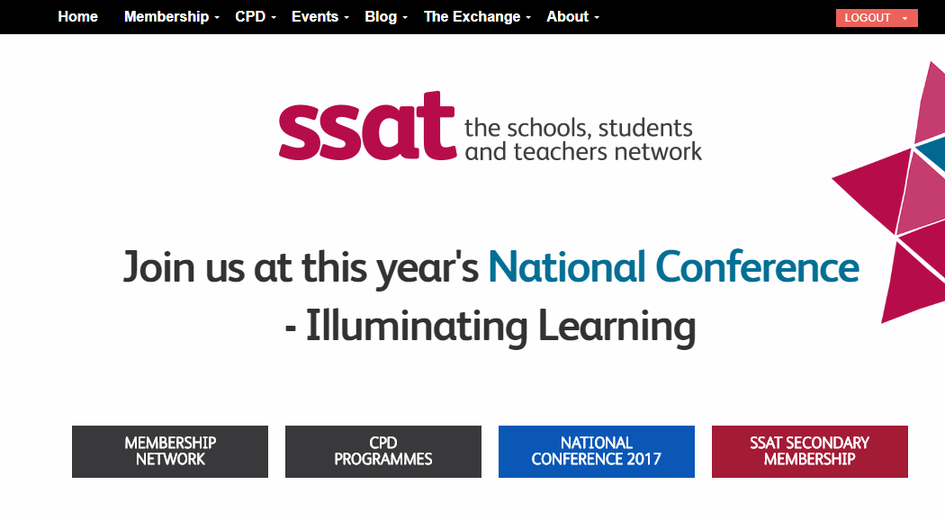
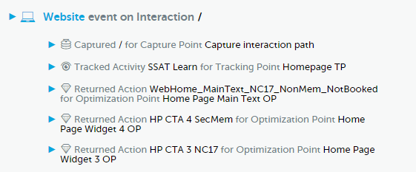
Customising web content – example 1
CC BY-NC-SA SSAT (The Schools Network) Ltd.
Notes:
Here is an example of how the home page is seen by a visitor who is either unrecognised, or recognised as a non member.
The panel to the right shows an extract of how ONE has processed this page view and inserted content

Slide 11
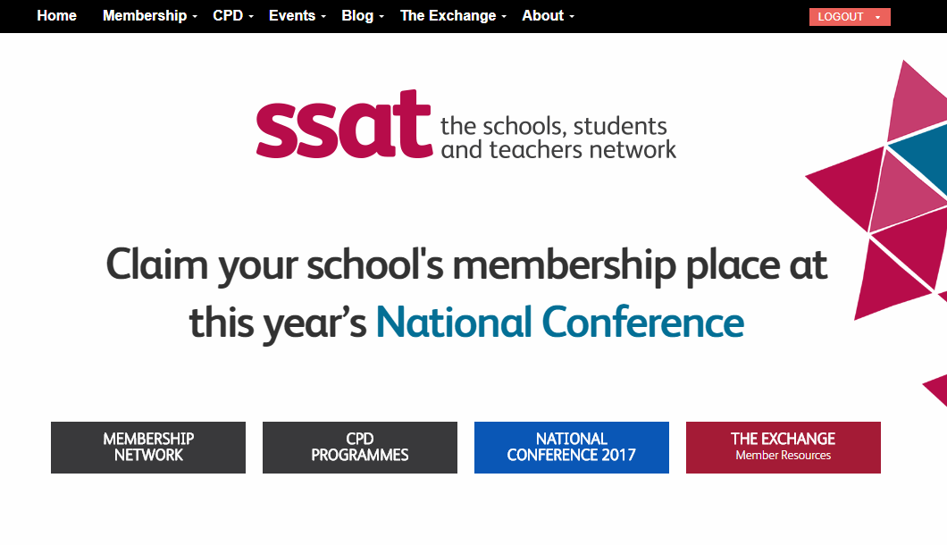
Customising web content – example 2
CC BY-NC-SA SSAT (The Schools Network) Ltd.
Notes:
This example is for a visitor who has been recognised, and based on data pulled from Dynamics is known to be a member, further that no-one from that school has yet booked,

Slide 12
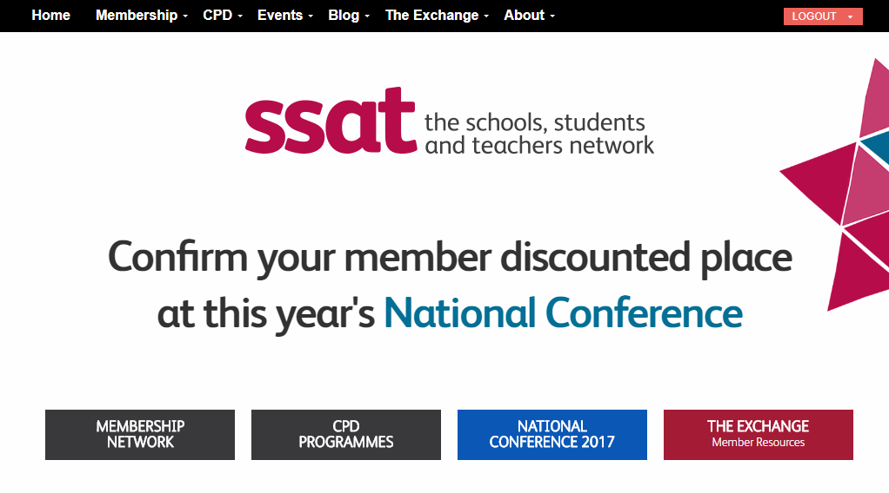
Customising web content – example 3
CC BY-NC-SA SSAT (The Schools Network) Ltd.
Notes:
This example is for a visitor who has been recognised, and based on data pulled from Dynamics is known to be a member, further that there are already bookings from that school,

Slide 13
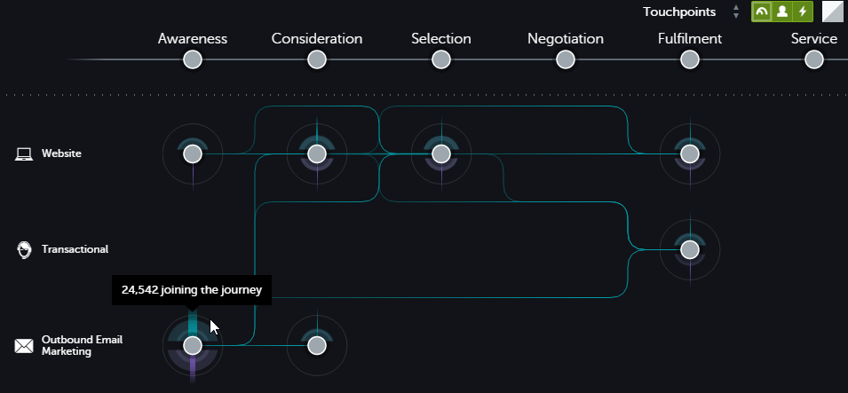
Analysing aggregate customer journey behaviour…
CC BY-NC-SA SSAT (The Schools Network) Ltd.
Notes:
Another aspect of this integration is the ability to look in aggregate at overall customer flow across touchpoints.
This example is for a recent 4 week period and is filtered to show only interactions relating to the National COnference

Slide 14
How ONE codes each interaction
Customer Key and/or Thunderhead Id
Journey Stage
Who?
Where are they on the journey?
Activity Type
Interaction
What are they interested in?
Proposition
CC BY-NC-SA SSAT (The Schools Network) Ltd.
Notes:
To achieve the magic ONE codes each customer interaction along three axes. For web views this is done by configuration within ONE, for other interactions the data can be pushed via the API
Identifying the customer is done at a couple of levels:
All interactions are associated within ONE wit ha TID (Thunderhead Id)
If we are able on a specific interaction to associate the customer wit ha known record in CRM, we can give ONE a “customer key”, which we choose to be the Contact ID from Dynamics. Subsequent interacitons against that TID are associated with that customer key, allowing data to be pulled from Dynamics
All interactions are coded against a “proposition” that defines the subject
All interactions are code to an Activity Type, and in turn activity types are coded to different parts of the customer journ

Slide 15
Who? – Customer Key
Mapped to Contact Id from CRM
Critical to design journeys with “identification events”
ONE can capture from cookies, query string or in data pushed to API e.g.
When customer logs in we place a cookie with Contact Id
On outbound email marketing we insert a merge tag on links with the ContactId
CC BY-NC-SA SSAT (The Schools Network) Ltd.
Notes:
Some of the ways we provide a customer key…

Slide 16
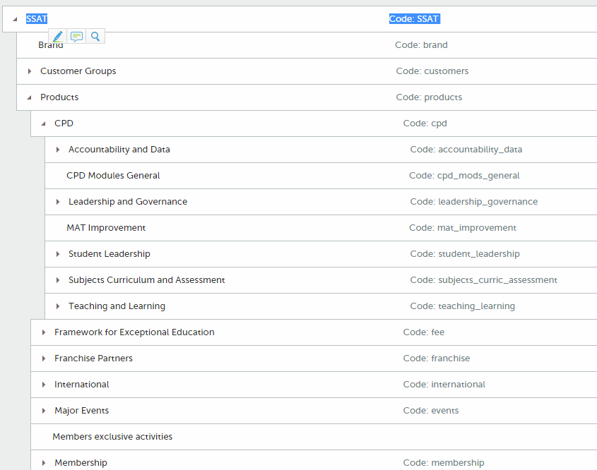
What are they interested in? - Propositions
CC BY-NC-SA SSAT (The Schools Network) Ltd.
Notes:
A section of our “Propositions” tree in ONE
There are three main branches:
Products
Major customer groups
Key discussion topics
To enable certain integrations we have replicated this data structure in Dynamics (manual sync though)

Slide 17
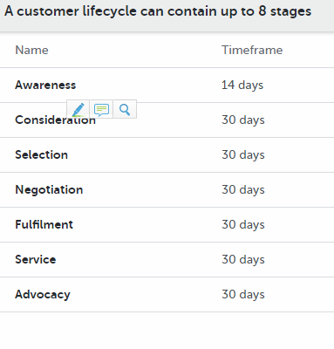
What does our customer journey look like?
CC BY-NC-SA SSAT (The Schools Network) Ltd.
Notes:
Our customer journey stages
The significance of the duration is that after that time, if a customer has not recorded another interaction on a given proposition they are shown as “dropping off” the journey
Most of the durations are currently at the default 30 days, but we are looking at further adjustments

Slide 18
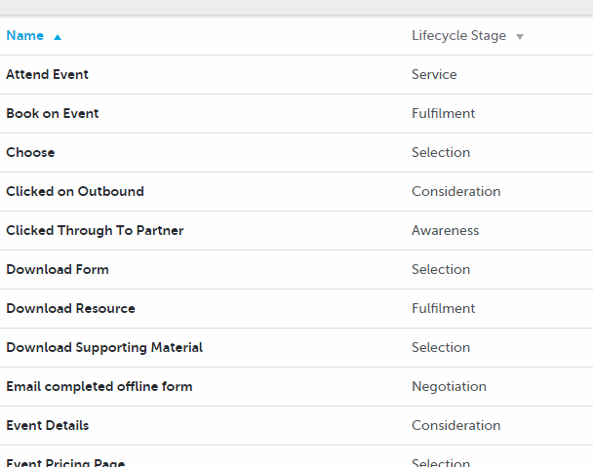
Where are they on the journey (activity type)?
CC BY-NC-SA SSAT (The Schools Network) Ltd.
Notes:
Some sample activity types we have coded, showing the journey stage

Slide 19
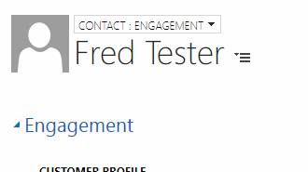
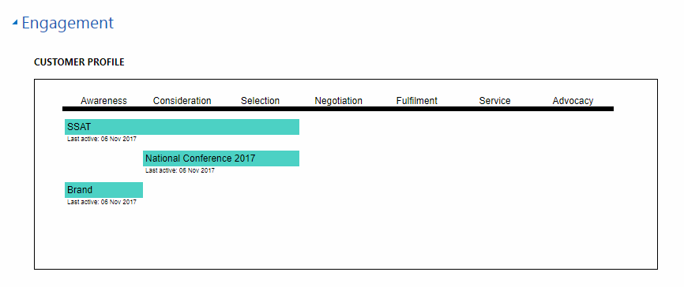
Insight within Dynamics context…
… allowing a sales agent to see up to date overview of customer behaviour, within the Contact Form …
CC BY-NC-SA SSAT (The Schools Network) Ltd.
Notes:
We also want to make individual journey data visible to people such as sales agents in the context of a Dynamics Contact record.
This display is created by a Dynamics WebResource containing a small Angular 1.x application that looks up the Contact Id from the parent record, pulls live journey data from ONE, then displays it using the D3.js library

Slide 20
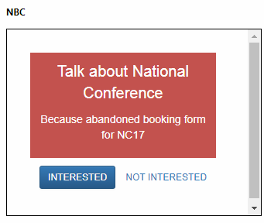
… guiding agent behaviour, again in context of Dynamics Contact form …
CC BY-NC-SA SSAT (The Schools Network) Ltd.
Notes:
Where as this widget is used to display messages to agents based on rules configured inside ONE that query the live dynamic customer profile.
ONE is aware if the Interested / Not interested buttons are clicked, and can use that information in further business rules

Slide 21
Our challenge as B2B…
We also want to see what all contacts at a given organisation are doing…
With the help of:
ONE interface to push data into Azure blob,
ONE API
some code in Azure Functions
an instance of CosmosDB
we were able to create a simple account-level aggregator
And expose via a popup within Dynamics….
CC BY-NC-SA SSAT (The Schools Network) Ltd.

Slide 22
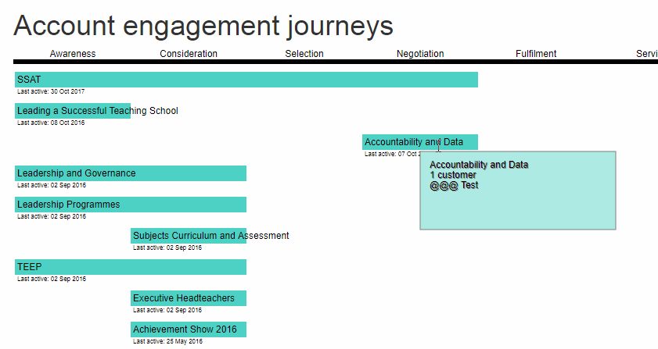
CC BY-NC-SA SSAT (The Schools Network) Ltd.
Notes:
This widget, displayed on a popup from the Account screen queries our custom aggregation code via a webhook in Azure Functions
It’s showing journey summaries for all contacts associated with an account, aggregated by proposition

Slide 23
We want to create leads based on customer interest…
We send weekly outbound marketing where each message covers several propositions (to reduce the volume)…
And from each message steer actions to several landing pages…
We want to create a lead when an individual demonstrates their interest in a specific proposition via a combination of opens, click-throughs and further web exploration…
CC BY-NC-SA SSAT (The Schools Network) Ltd.
Notes:
We have recently moved on from specific lead-generation steps (e.g. around form submissions) to capture more widely interest in a given proposition

Slide 24
CC BY-NC-SA SSAT (The Schools Network) Ltd.
Notes:
Here’s an example where ONE has pushed a lead into Dynamics,
the Lead that has been created (after some further post-processing in Dynamics),
And an interaction that has been pushed back from Dynamics to ONE to say “thankw,e got that one”

Slide 25
CC BY-NC-SA SSAT (The Schools Network) Ltd.
Notes:
Here’s the expression inside ONE that determines whether to push a lead…
“Total diminished” looks at the number of recent interactions by that customer for that proposition, reduced with a time function to emphasise recency

Slide 26
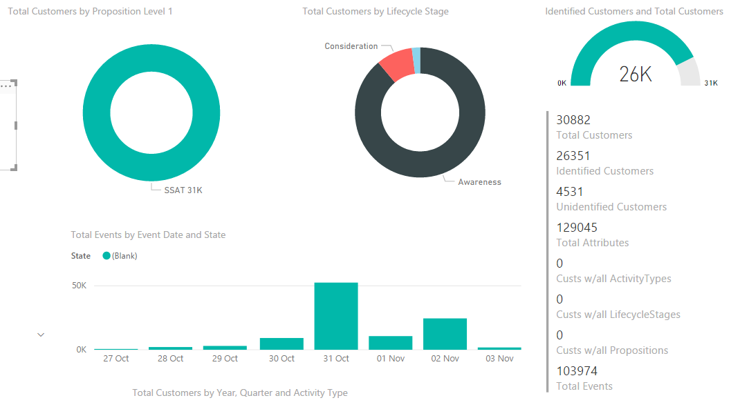
We are also developing insight to aggregate behaviour…
Scheduled data export from ONE
Thunderhead provide “starter template” for Power BI…
CC BY-NC-SA SSAT (The Schools Network) Ltd.
Notes:
And lastly, we are just getting started with bulk analytics of data from ONE.
As this is keyed against Dynamics Contact Id there is no reason why we couldn’t combine with other data sources…

Slide 27
Main integrations implemented
Touchpoint / data flow | Technologies
Listening to website | “ONE Tag” script WordPress customisations (PHP and JS)
Pulling data from CRM | ONE native functionality
Pushing data to CRM (e.g. leads) | Direct ONE ⇨ CRM ONE ⇨ Webhook ⇨ Azure ⇨ CRM
Marketing email events | PowerMailChimp ⬄ MailChimp CRM customisations ⇨ ONE
Displaying journeys and NBC for contact | CRM customisation ⇦ ONE API
Displaying aggregated account journeys | ONE ⇨ Azure Blob Azure Functions / CosmosDB CRM customisation (Web resource)
CC BY-NC-SA SSAT (The Schools Network) Ltd.
Notes:
The key technical integrations and technologies used

Slide 28
Thank you for listening!
Julian Elvé
Julian.Elve@ssatuk.co.uk
@synesthesia https://ssatuk.co.uk
http://www.synesthesia.co.uk
Fernando Barretto
Fbarretto@Thunderhead.com
CC BY-NC-SA SSAT (The Schools Network) Ltd.

