Slide 1
Future of TV Consumption
By Jonah Guo
Oct , 2014

Slide 2
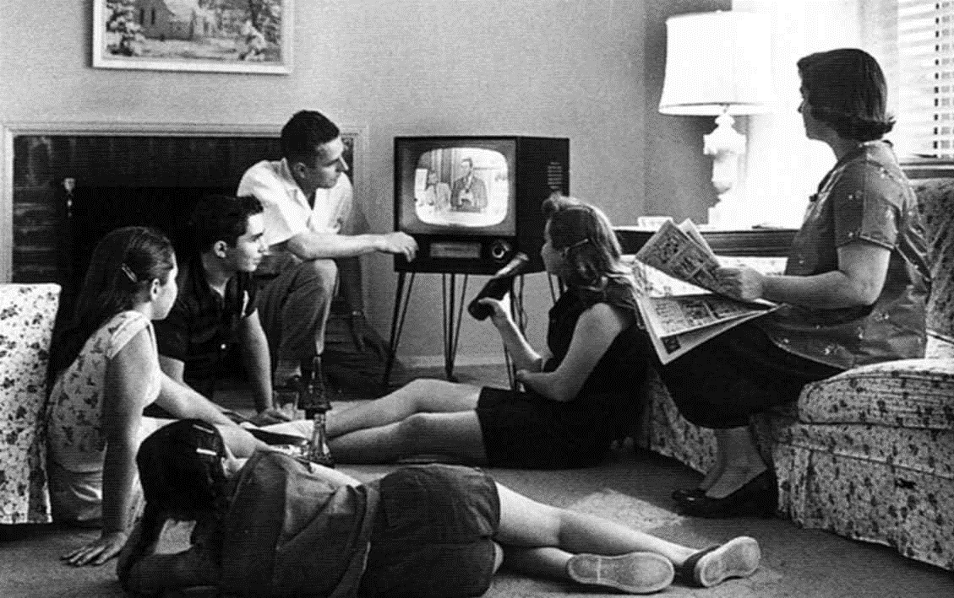
The World Has Been Changing
It Used to Be Like This

Slide 3
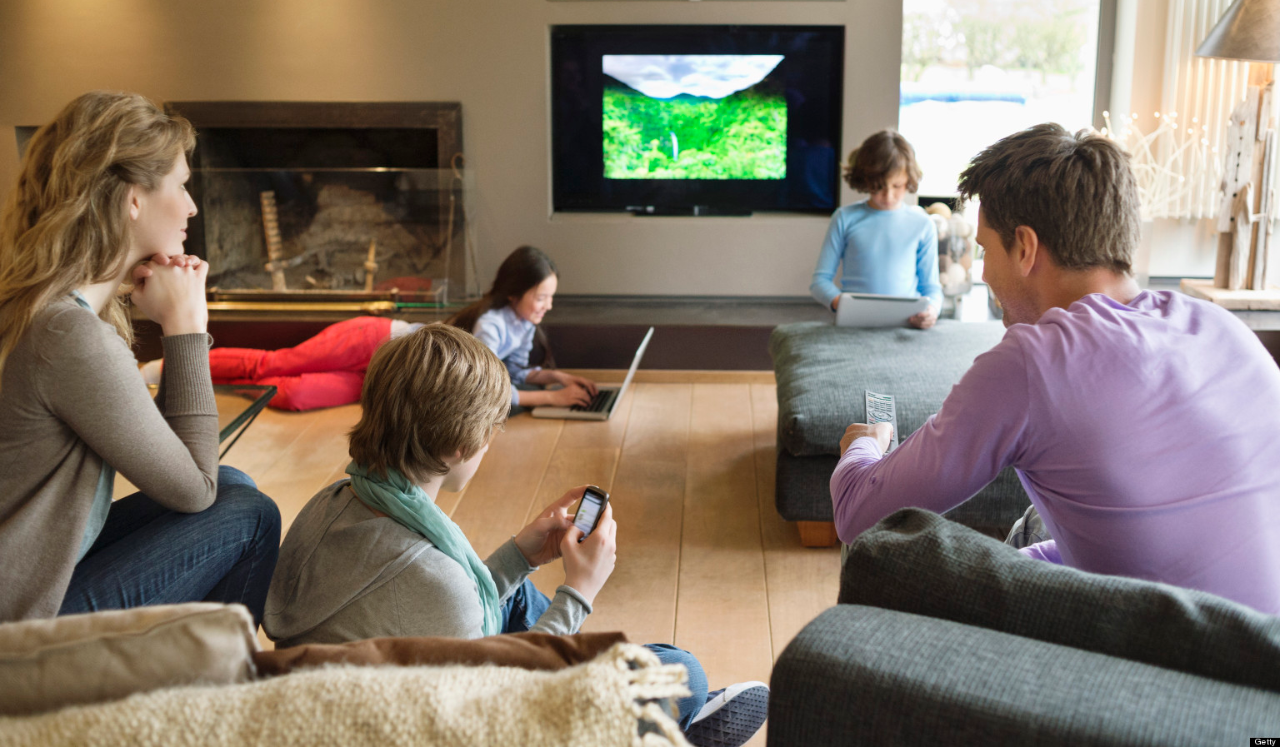
But Not Anymore

Slide 4
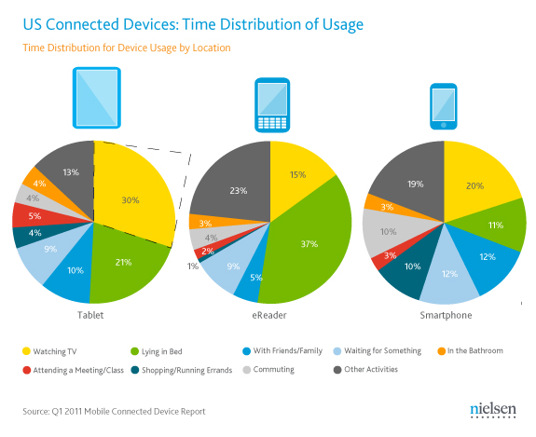

Slide 5
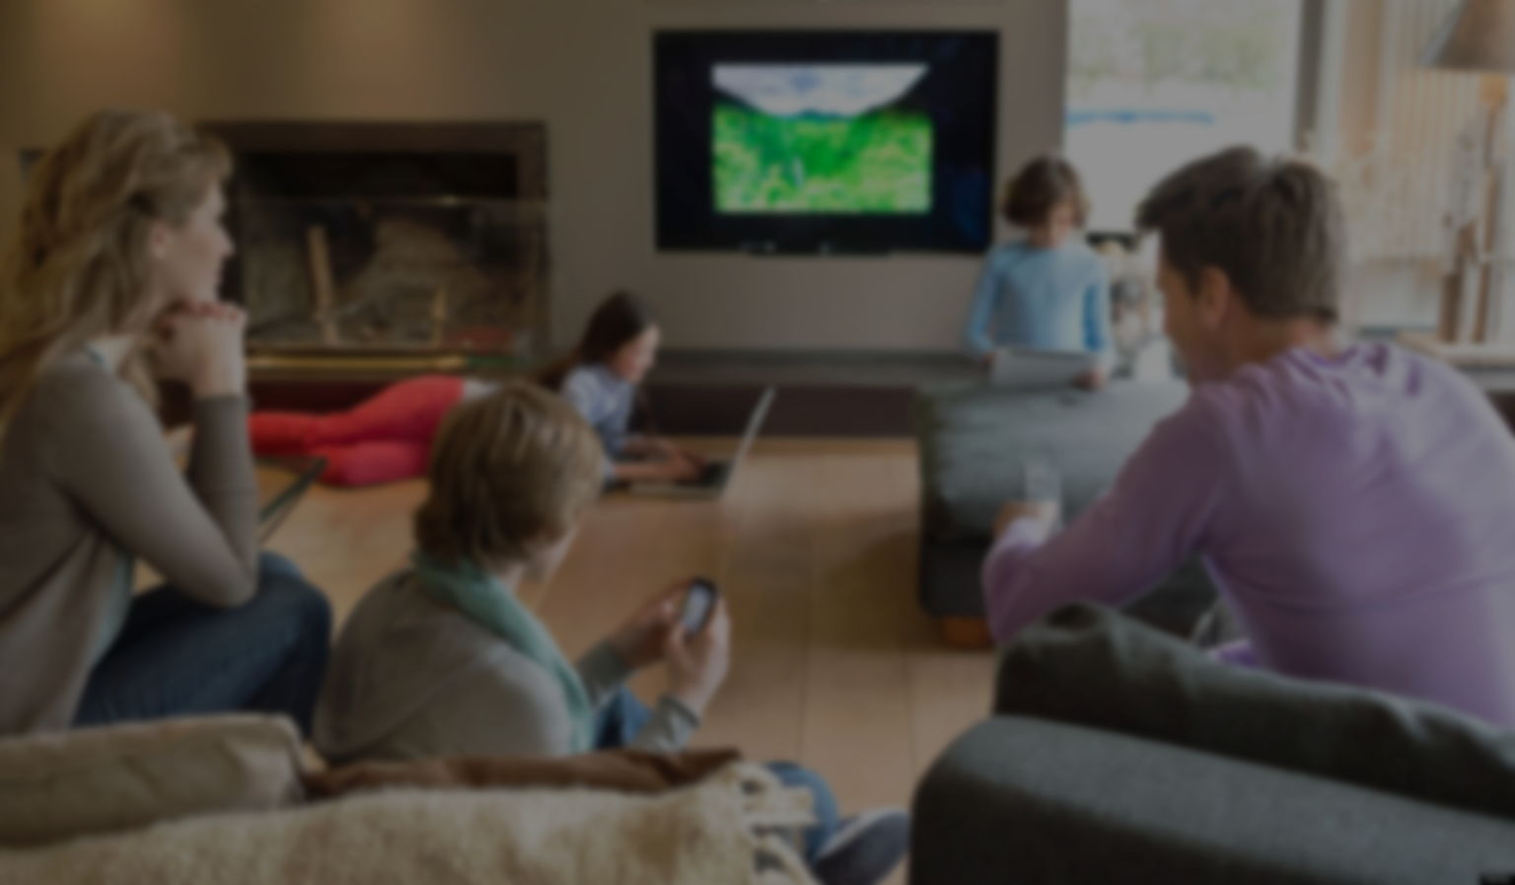
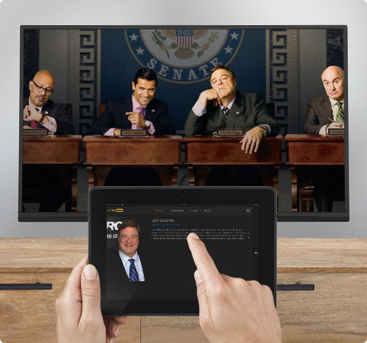
Bigger Screen, Ultra-HD
Faster Connection
4G, Fiber
Multiscreen
Data, Indiv. Profile
Machine Learning
Standalone Apps
Notes:
http://blog.360i.com/social-marketing/5-trends-in-tv-consumption
<number>

Slide 6
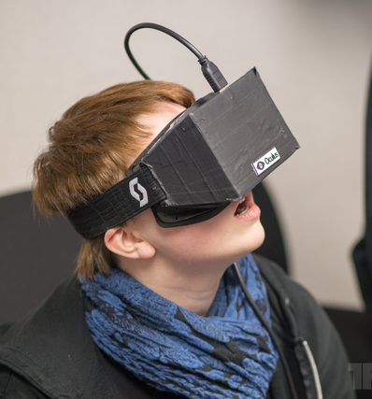
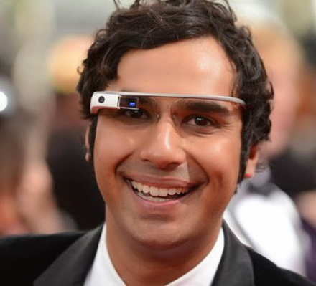
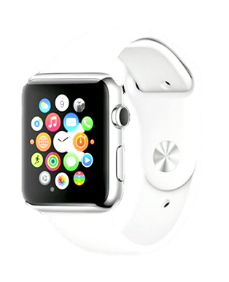
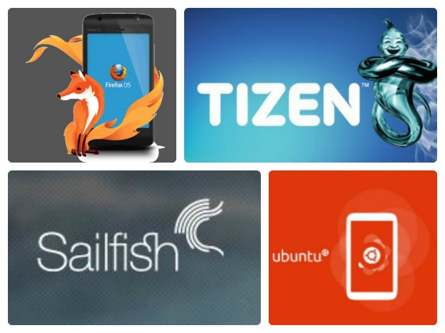
More Platforms to Consume Content
VR Devices
Google Glass
Smart Watch
Firefox Tizen
Sailfish Ubuntu

Slide 7
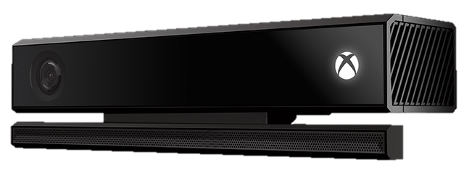
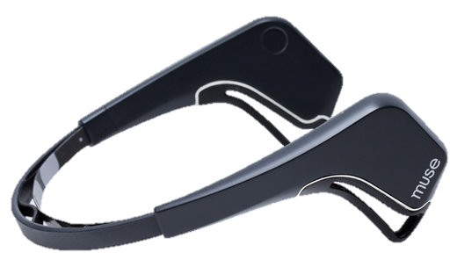
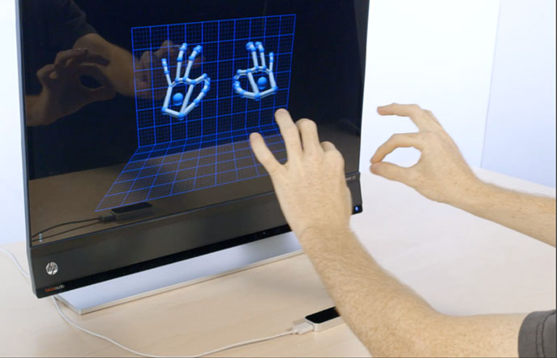
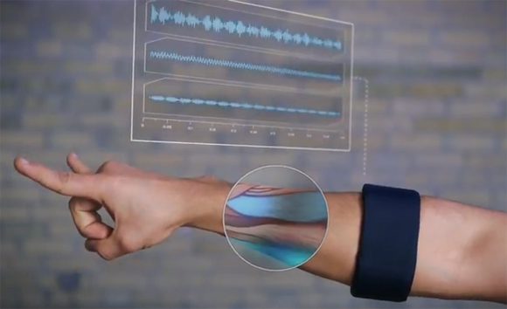
More Ways to Communicate with Content
Voice
Motion
Gesture
…
Mind
Notes:
Myo arm band
<number>

Slide 8
But
Some Things Never Change

Slide 9
Human Nature Never Changed
Happiness
Dream
Love
Family
Respect
Value
Friend
Community
Share
Notes:
<number>

Slide 10
Business Model Hasn’t Changed, A Lot
Big Data
Consumer
Content Provider
Service Provider
Content
Advertiser
Sell Content to Consumer
Sell Consumer to Advertiser

Slide 11
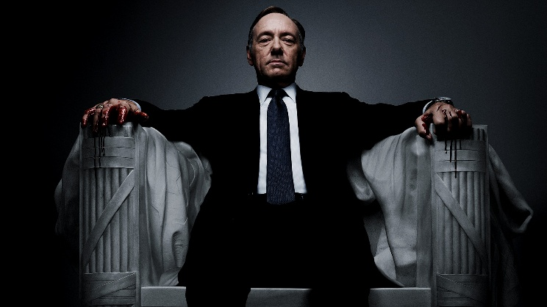
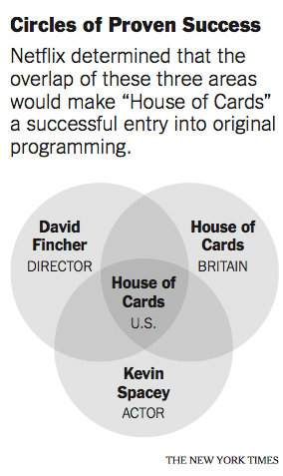
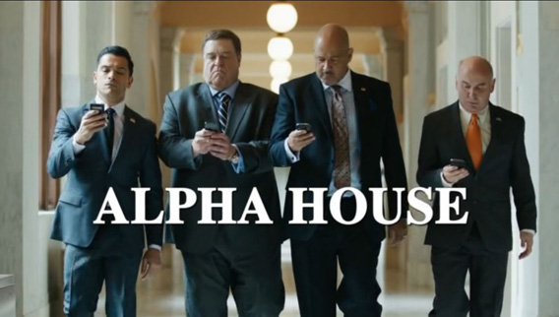
Value of Big Data Analytics
Improve Content Relevance
Improve Targeting
Accuracy
= ROI

Slide 12
So
Who Is Going to Be the
Winner
This Time ?

Slide 13
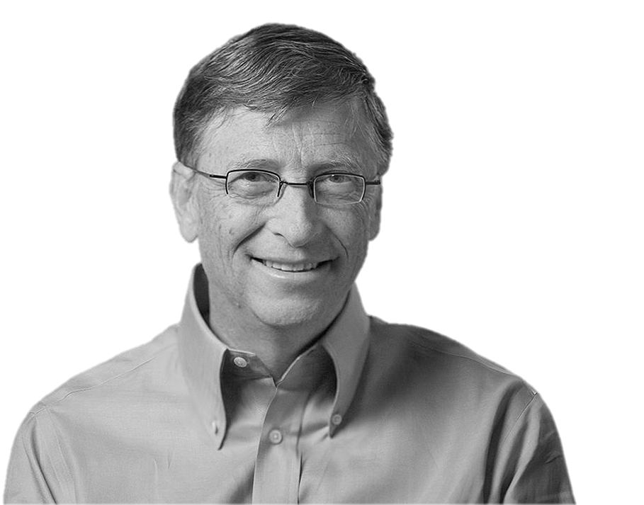
Content Is King
“The television revolution that began half a century ago spawned a number of industries, including the manufacturing of TV sets,
but the long-term winners were those who used the medium to deliver
information and entertainment. ”
- Bill Gates, Jan 3,1996

Slide 14
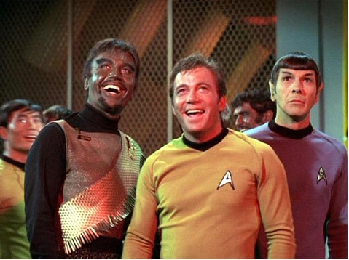
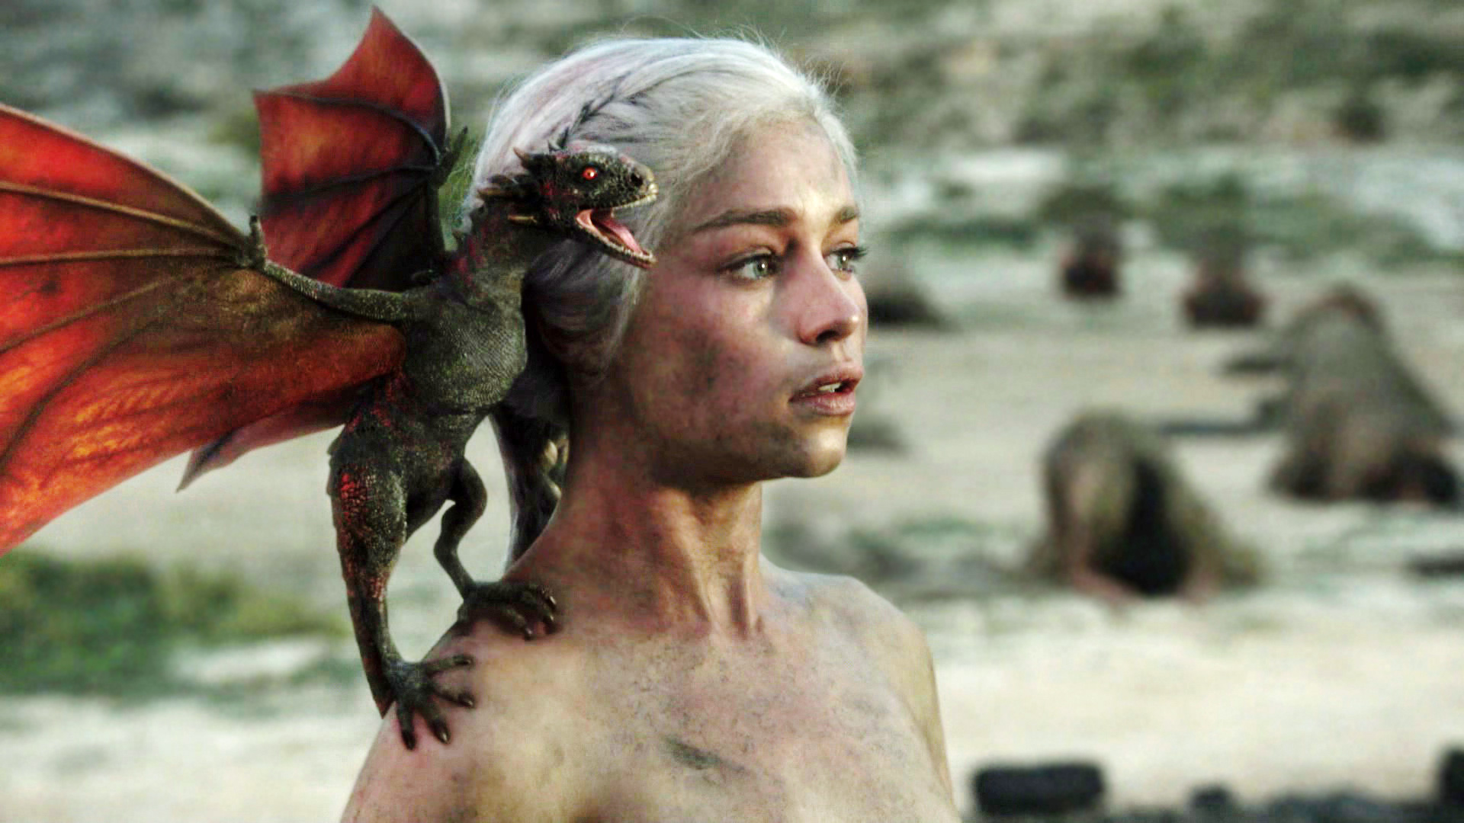
Remember The Moments We Got Really

Slide 15
and Go Back to the Human Nature to
Create More

